Slide 1
WELCOME
Mohima Binte Parvez
Roll: 20
Batch: 46
Project: The Impact of Climate Change on Agriculture
Course: Computer Fundamental & Office Applications

Slide 2
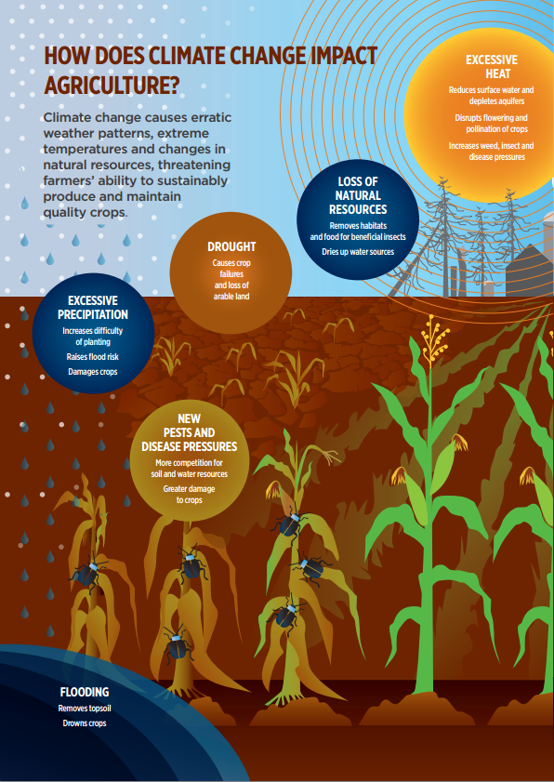
.
This project examines how climate change affects agriculture, focusing on key factors such as temperature, rainfall, and extreme weather events. By analyzing regional data on crops like wheat, corn, and rice, the study reveals significant variations in crop yields influenced by climatic changes

Slide 3
This research highlights the need for global cooperation to combat climate change and safeguard sustainable agriculture.
I want to play! >>

Slide 4
Importance of the Project:
This project is vital for understanding how climate change impacts agriculture, a cornerstone of global food security and livelihoods. It identifies key vulnerabilities in crop production due to changing rainfall patterns, rising temperatures, and extreme weather events. Ultimately, the project contributes to ensuring sustainable agriculture and reducing the threat of food insecurity in a warming world.

Slide 6
Fig: Correlation

Slide 7
Insights from Correlation:
A strong negative correlation (e.g., -0.8) between average temperature and yield.
A moderate positive correlation (e.g., +0.5) between rainfall and yield could imply that crops benefit from moderate rainfall, but excessive rainfall (flooding) might disrupt growth.

Slide 8
This project explores the impact of climate change on agriculture by analyzing how factors like temperature, rainfall, and extreme weather events affect crop yields across regions. It highlights the need for adaptive strategies, such as resilient crops and improved farming practices, to mitigate risks and ensure food security in a changing climate.

Slide 9


Next >

